Slide 1
Bandai Namco Initial Pitch Level 4/5 Group 5
Henry Crofts, Ashley Long, Samuel McMillan and Dawid Hojka

Slide 2
The Brief
2D Game
One Tap Mechanic
Casual Gamers
Turn based
Feedback

Slide 3
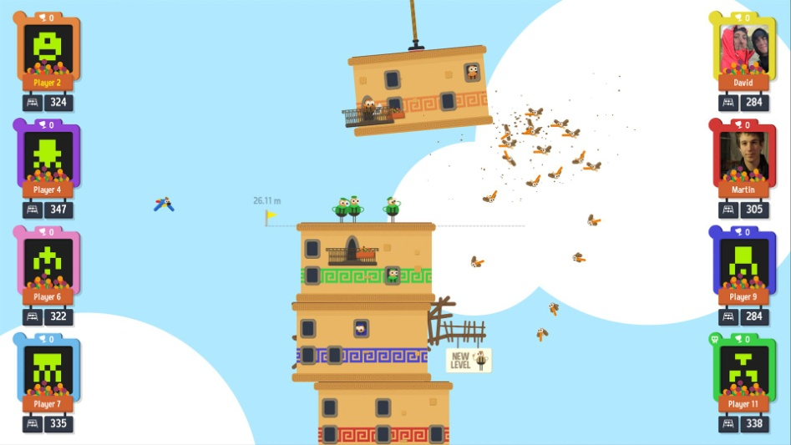

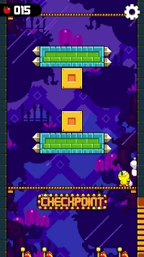
Research
Clarity of layout.
Simplicity.
Gratification.
What these games taught us?
Tower of Babel
One More Line
Leap Day

Slide 4
Demographic
Age Group (10 – 18)
Gender (male)
Psychographics (achievers)
Pleasures

Slide 5
Game Ideas
Communication Lines
- Symmetric. Element of competition.
- No rewards. Hard to play on single device.
Pendulum Swing
- Symmetric. Simple rules.
- Not within the demographics.

Slide 6
Game Ideas Continued
Rhythm Game
- Fun and engaging. Rewards for completing objectives.
- Endless runner.
Quick Maths
- Educational. Simple.
- Short player base. Player two could copy player one’s answer.

Slide 7
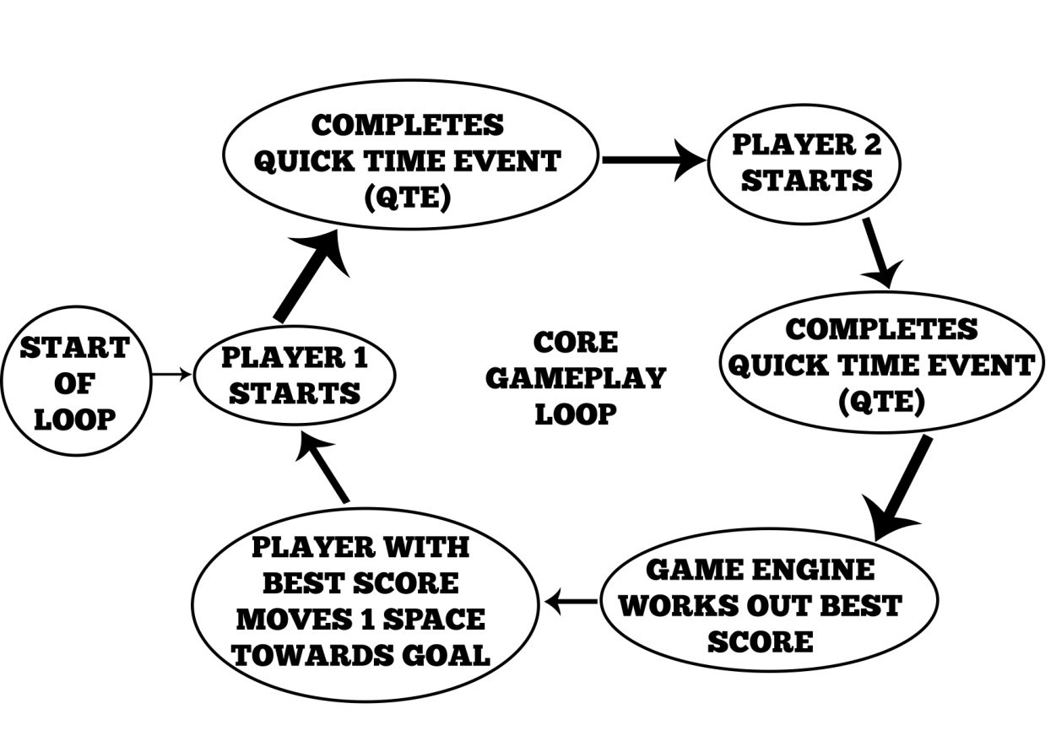
Concept Idea
What we changed?
Endless runner -> Tug-of-war.
Both players on the screen at once.
Mechanics
Quick-time-events.
Twitch mechanic.
Learn-pracitce-master.
How it fits the brief?
Symmetric. Adversarial.

Slide 8
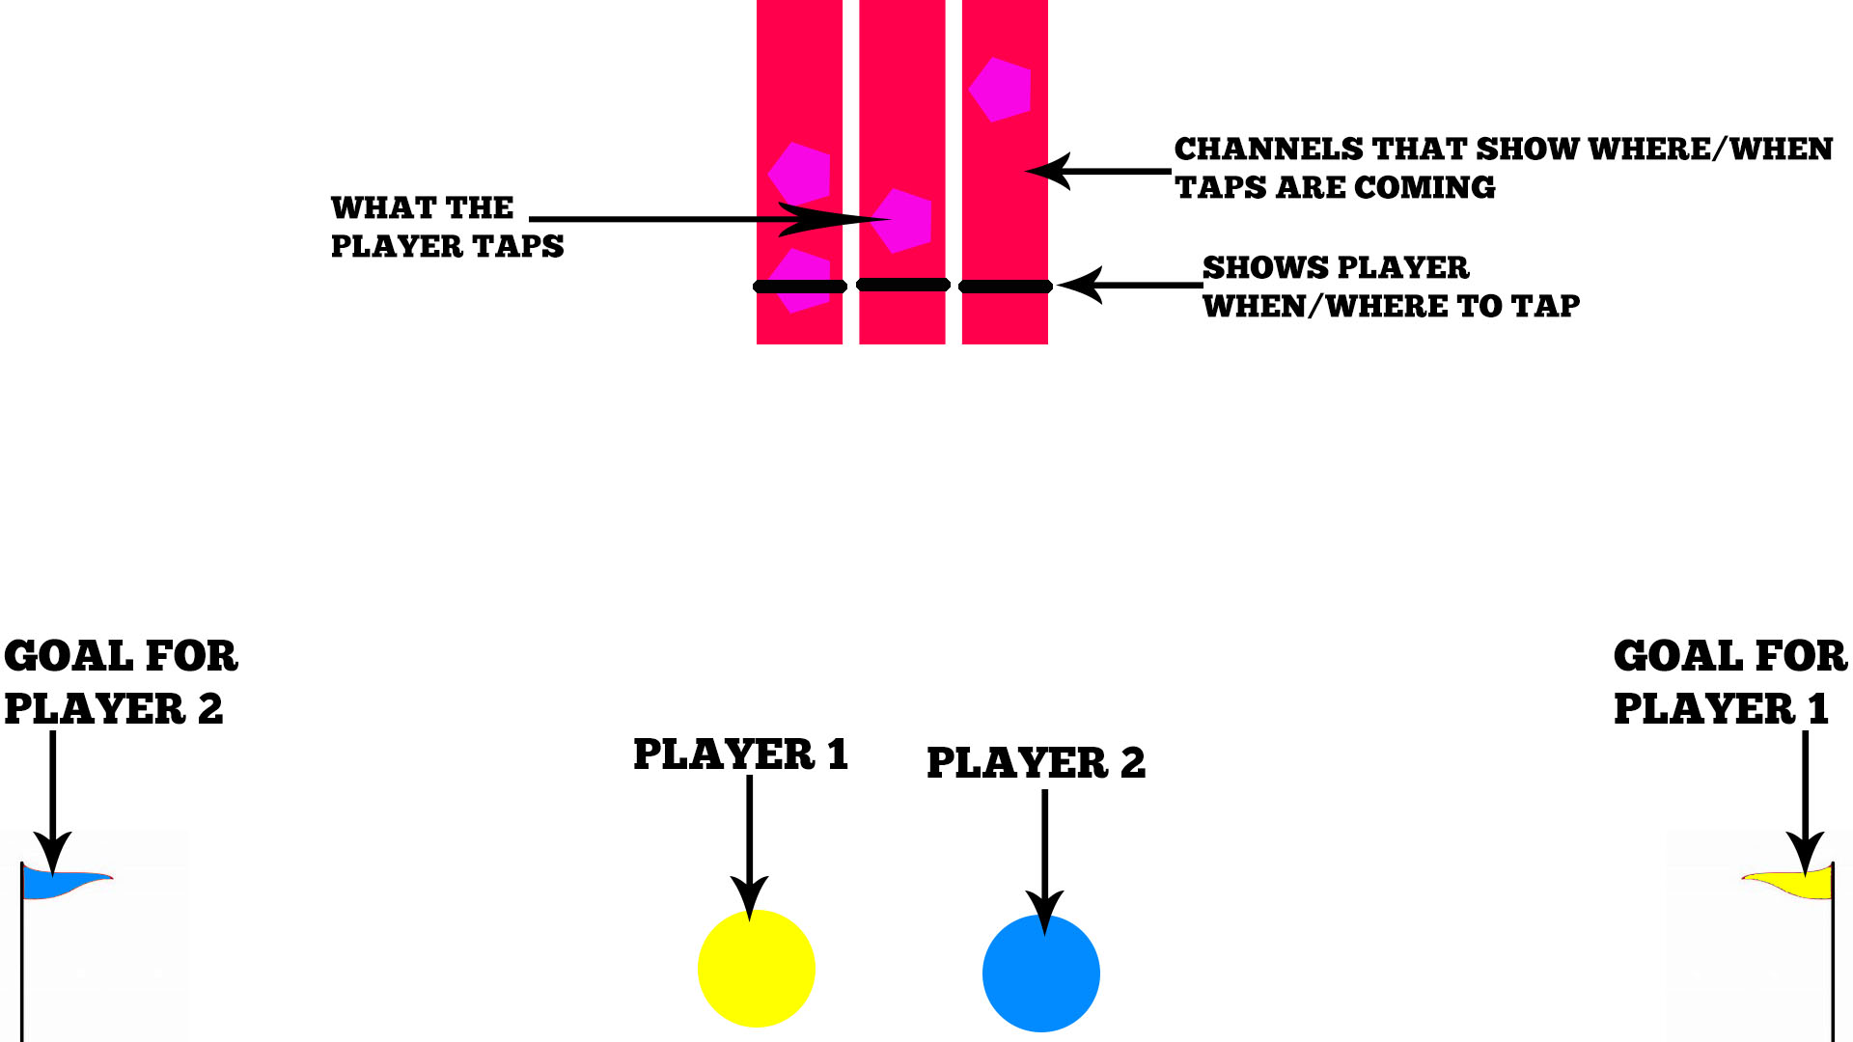

Slide 9
Theme
Food
Appropriate for the demographic.
Flexible to work with.
Exaggarated for comedic purposes.

Slide 10


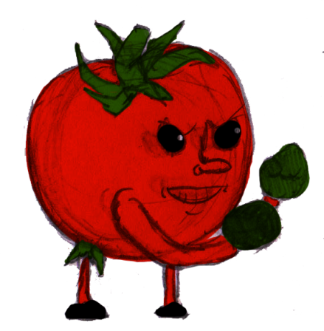
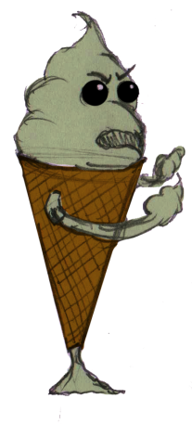
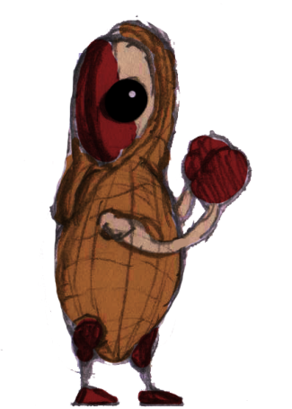
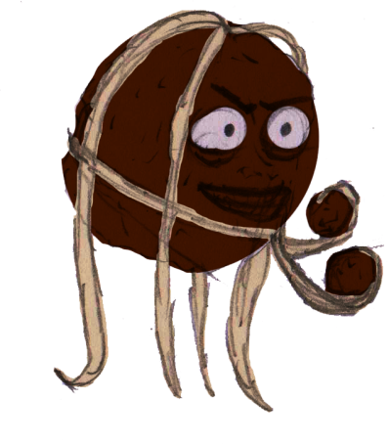
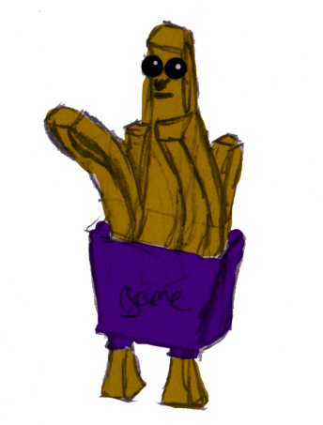
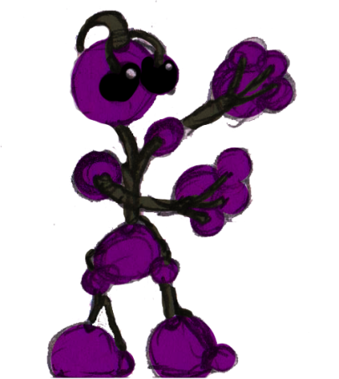
Concept Art
Background concept
Character concepts

Slide 11
Questions?

